Slide 1
SiPM-based Camera for the Image Air Cherenkov Telescope of LHAASO
Shoushan Zhang for LHAASO collaboration
Institute of High Energy Physics, Beijing, China
KIAA-WAP II, Aug. 17-19, 2017, Beijing

Slide 2
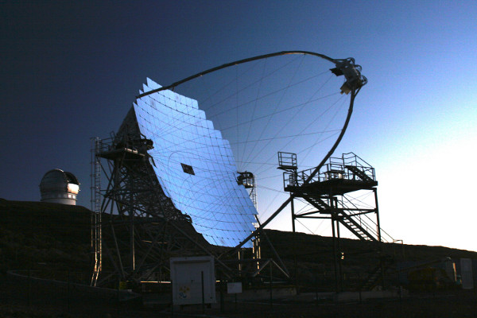
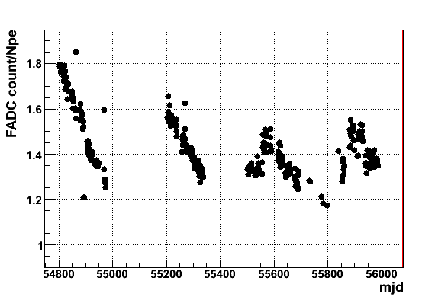
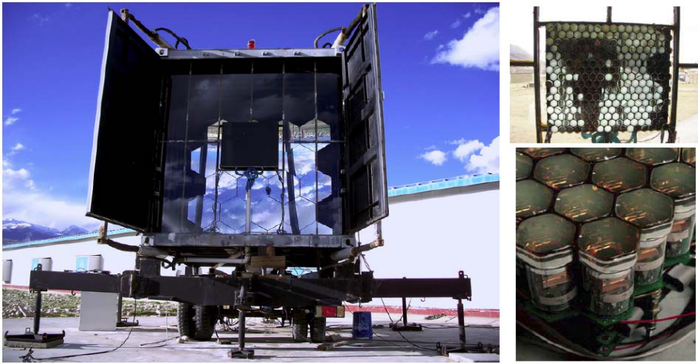
Motivation
PMT-based Image Air Cherenkov Telescope and Fluorescence Detector：
  Image Air Cherenkov Telescope： VERITAS，HESS，MAGIC …
  Florescence Detector：HIRES，TA，AUGER …
  Run on a moonless night
  PMT aging or damaged due to strong light exposure
  Duty cycle: ~10%
How to get a higher duty cycle?
LHAASO-WFCTA prototype (PMT-based)
LHAASO-WFCTA 样机PMT阵列增益随时间的演化
PMT aging with time

Slide 3
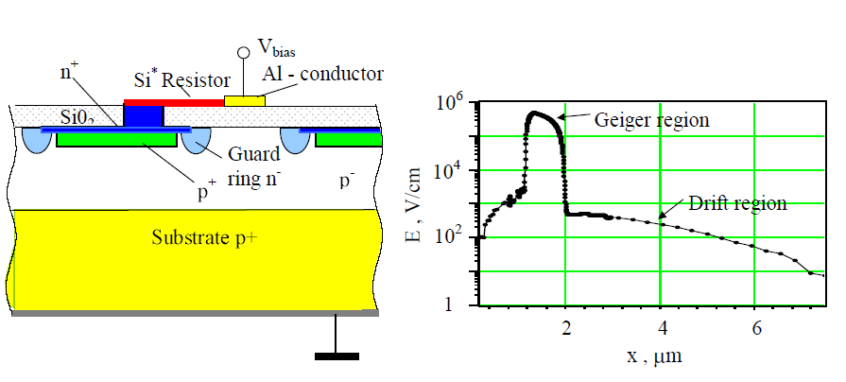
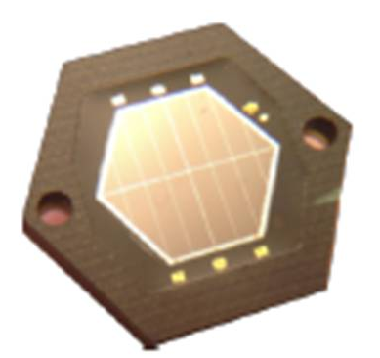
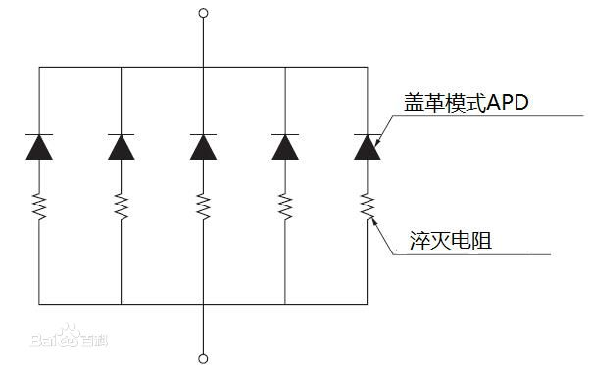
Silicon photomultiplier (SiPM)
Advantages: photon counting response, high detection efficiency, high gain at low bias voltage，no aging due to light exposure and no sensitive to magnetic fields.
SiPM can not be aging due to strong light exposure: SiPM-based camera can be operated in moon conditions, thus achieve a higher duty cycle than PMT-based camera. The duty cycle of SiPM-based camera is about 30%, while the PMT is only 10%.
Is made of an (APD + quenching resistor ) array
APD: operates in Geiger mode, the output signal is 0 and 1 analog signal
APD size: 15 μm – 100 μm
1600 APDs/mm² （25μm）

Slide 4
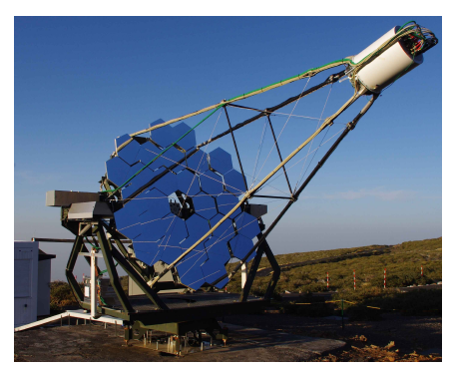
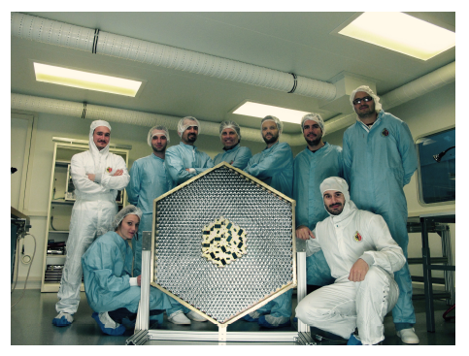
Application example
The first G-APD Cherenkov telescope （FAST）： La Palma, Canary Islands, Spain，2011 (prototype)
  FOV ：4.5°，1440 pixels，mirror size: 9.5㎡，pixel size：0.11°
CTA: Single mirror small size telescope (5 TeV – 300 TeV), Schwarzschild-Couder telescope
CTA：SiPM-based camera
FACT

Slide 5
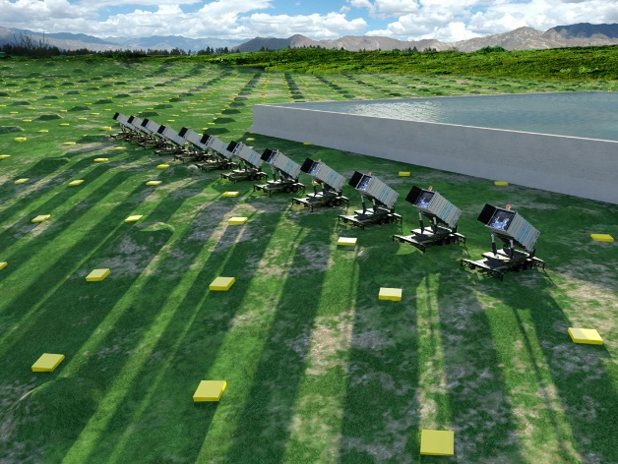
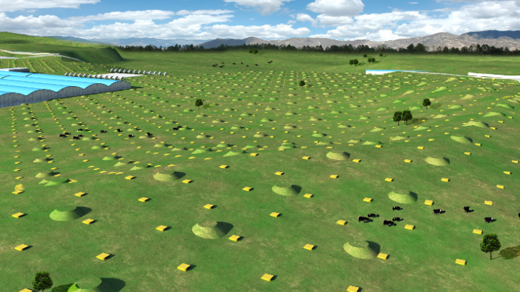
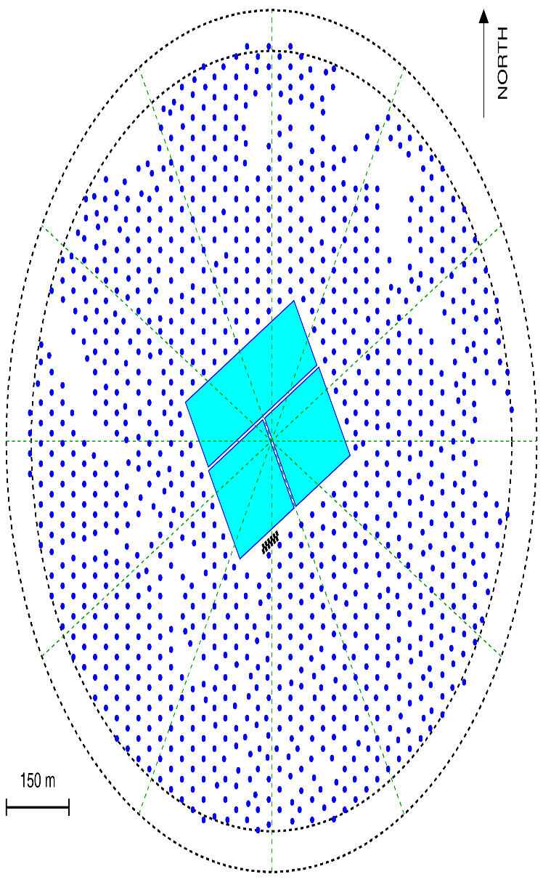
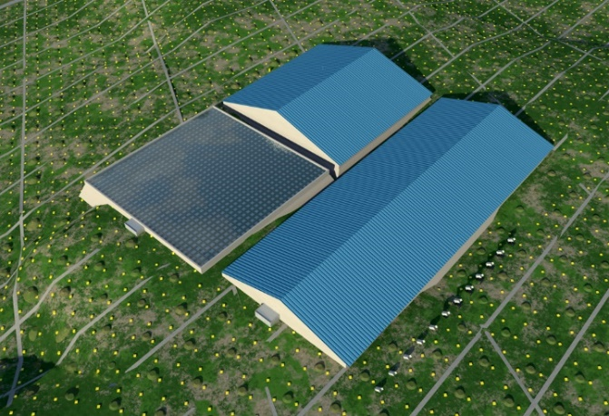
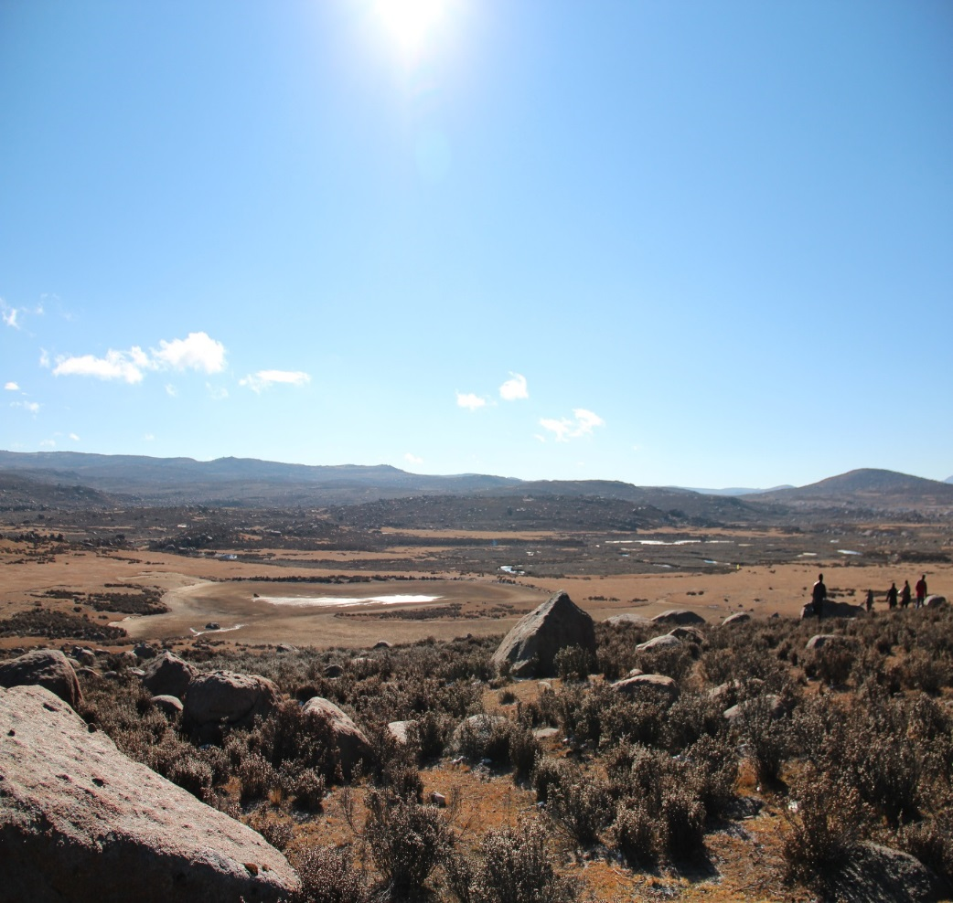
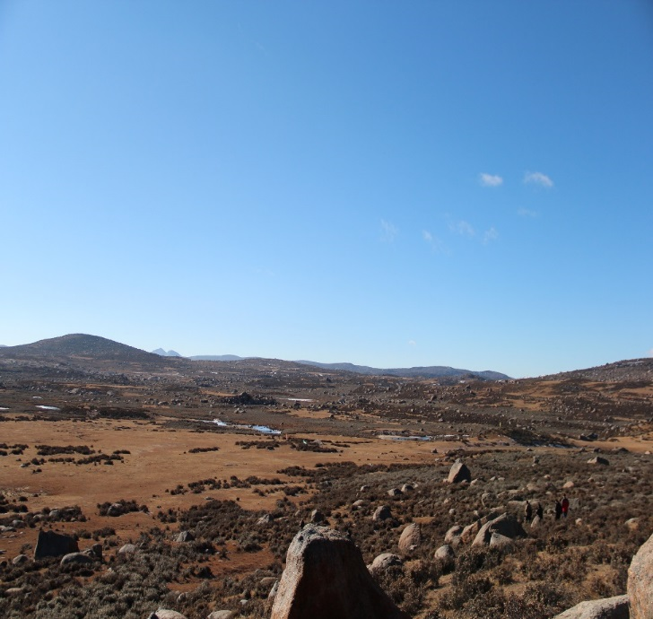
LHAASO
KM2A:
5195 EDs
1171 MDs
WFCTA:
16 Cherenkov telescopes (1024 pixels/telescope)
WCDA:78,000 m² 3000 cells (25m²/cell)
Daochen, Sichuan (29º21’ 31” N, 100º08’15” E, 4410 m a.s.l., 600 g/cm)

Slide 6
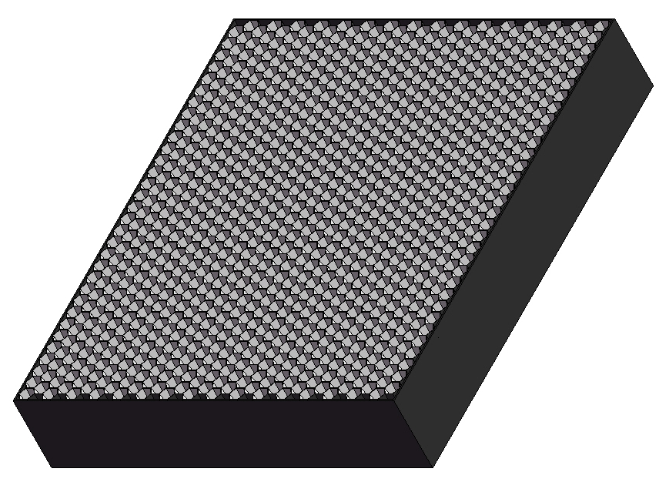
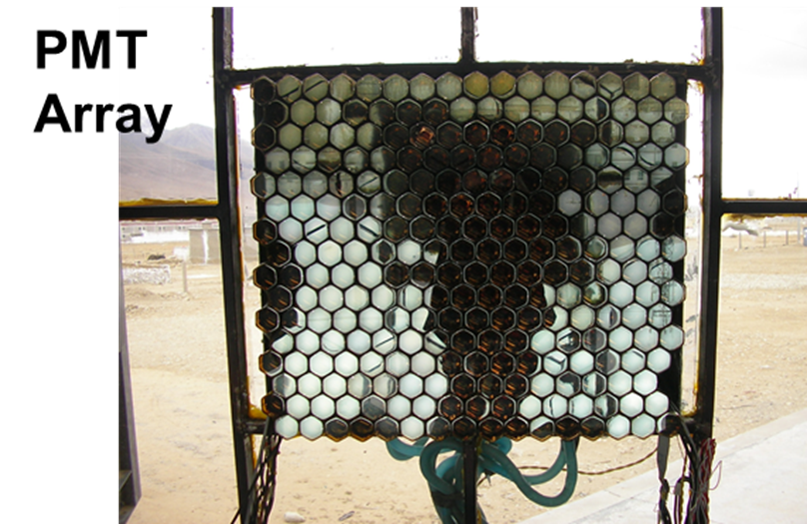
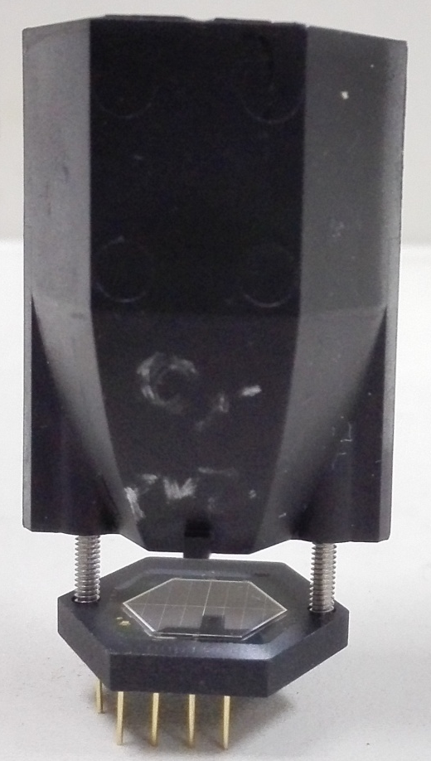
Wide Field of View Cherenkov Telescope (WFCTA)
5m² spherical mirror；
32×32 SiPMs array
Pixel size 0.5°；
FOV: 14°× 16°.
instead of
SiPM camera
A prototype of WFCTA

Slide 7
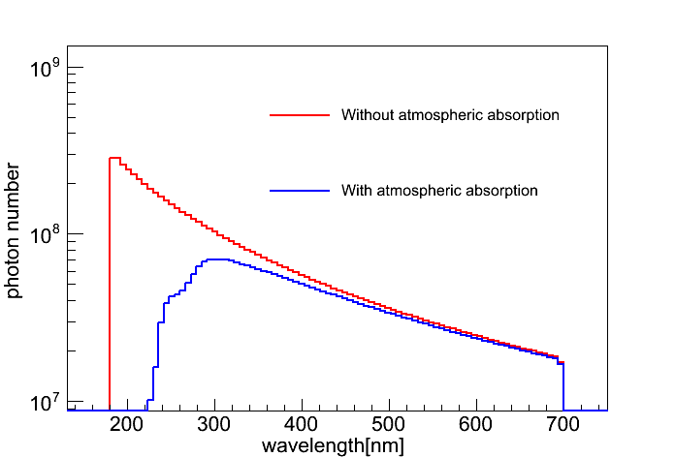
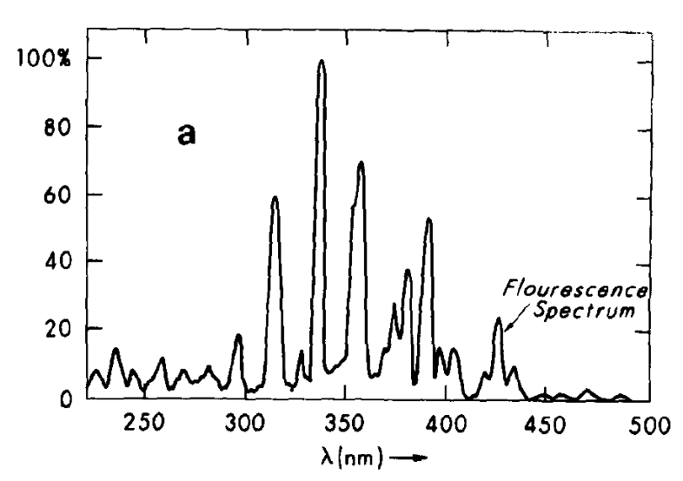
LHAASO-WFCTA vs. CTA
 | CTA-SSTs | LHAASO-WFCTA
Energy range | 5 TeV – 300 TeV | 30 TeV – 1 EeV (Cherenkov mode: 30TeV – 10 PeV, 10PeV-100PeV; Fluorescence mode: > 100PeV)
Diameter of mirror | ~ 4 m | ~ 2.3 m
Pixel size | ~ 0.25 | ~ 0.5
Number of pixels | 1296 | 1024
Dynamic range | 1 pe - 2000 pe | 10 pe – 32000 pe
Light pulse duration | 6 ns - 50 ns | 6 ns - 3 μs
Observation mode | Cherenkov light | Cherenkov and Fluorescence light
Air shower Cherenkov light spectrum
Fluorescence light spectrum

Slide 8
SiPM vs. PMT
 | SiPM | PMT
Dynamic range | Proportional to the total number of APD cells | Dependent on PMT type, HV distribution and readout method
Photon counting | Yes | No
Charge resolution | 12-13%@100pe，4%-5%@1000pe | 12%@100pe, 4%@1000pe
Pulse duration | 20 - 60 ns | ~6 ns
Dark count rate | ~80 kHz/mm² @ thrd=0.5 pe | <1kHz @ thrd=0.5 pe
Aging@strong light exposure | No aging | Aging
Magnetic fields | No sensitive | Sensitive
Gain | 1×10⁶ @ several tens volts | 1×10⁶ @ >1000 V
Gain vs. temperature | ~1.5%/℃ | ~0.2%/℃

Slide 9
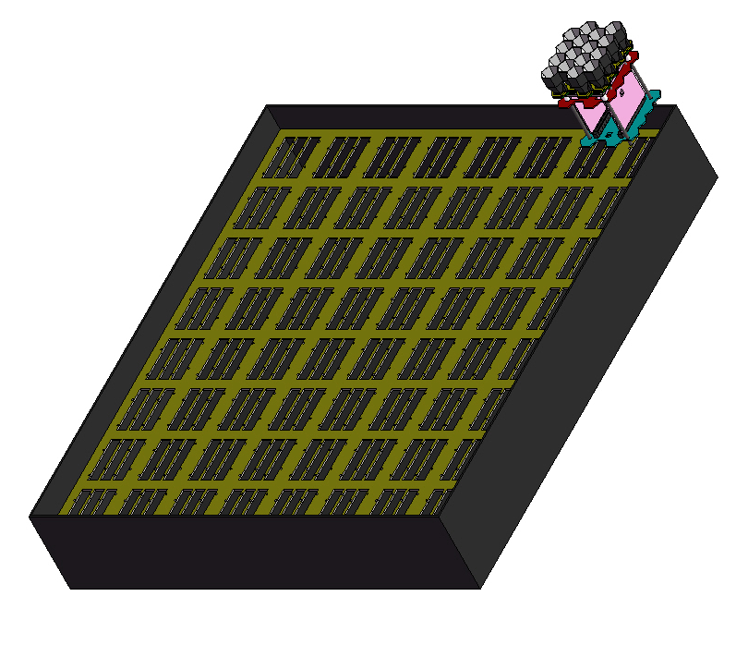
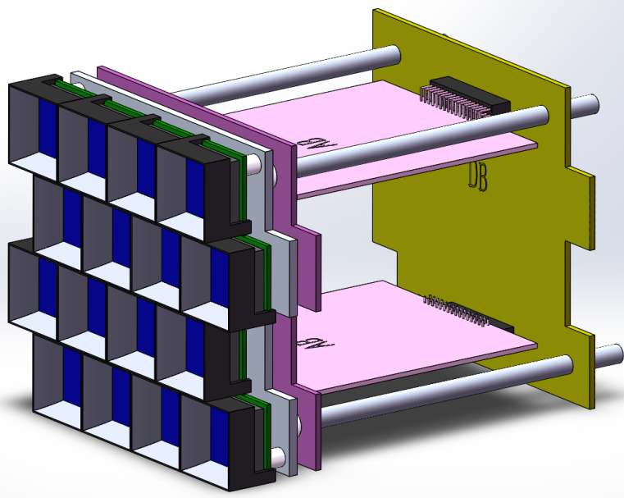
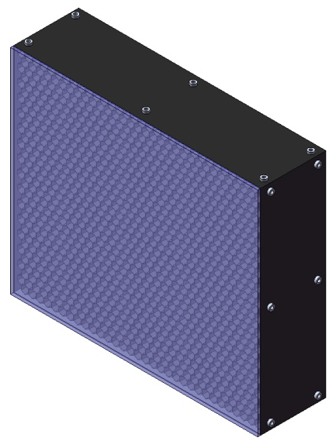
Schematic diagram of SiPM camera assembly
64 ×
AB2
AB1
Cluster
A module has 4×4 SiPMs.
SiPM camera box
DB
SiPM camera：32×32 SiPMs
Optical filter

Slide 10
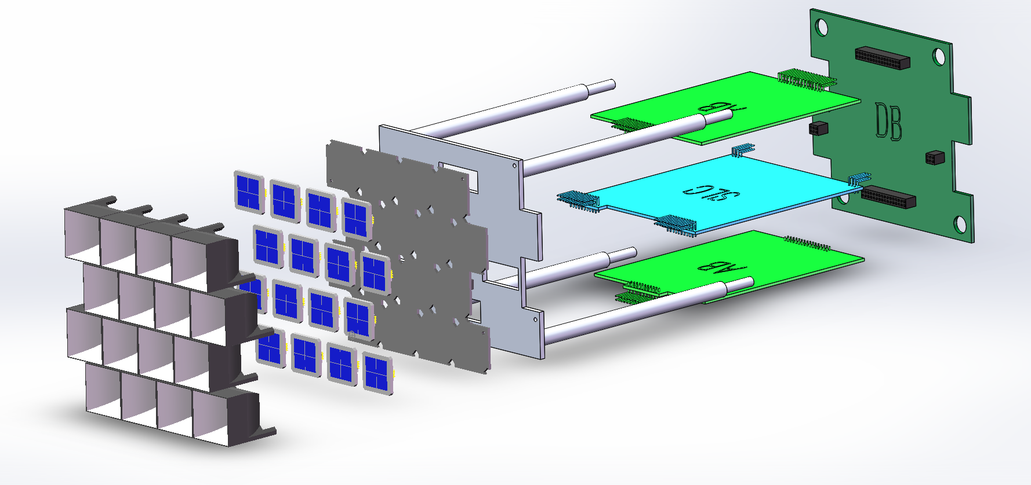
  Square SiPM：15 mm×15 mm
Digital Board
Metal frame
Analog Board
SiPM board
Winston cone
Slow control
board
Light concentrator (Winston cone): is to increase the effective area of the SiPM
SiPM board: 16 SiPMs, 16 temperature sensors (embedded in the SiPM chip ), and 16 pre-amplifiers
Slow control board:
  16 temperature and high voltage compensation loops;
  16 channels of high voltage power supply.
Analogue board: 16 channels of amplifier and shaping circuit
Digital board: 50 MHz FADC and FPGA

Slide 11
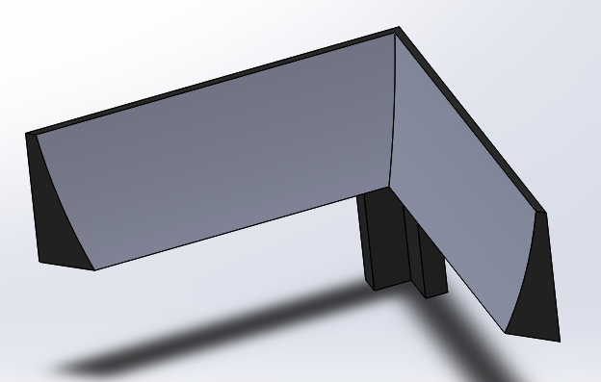
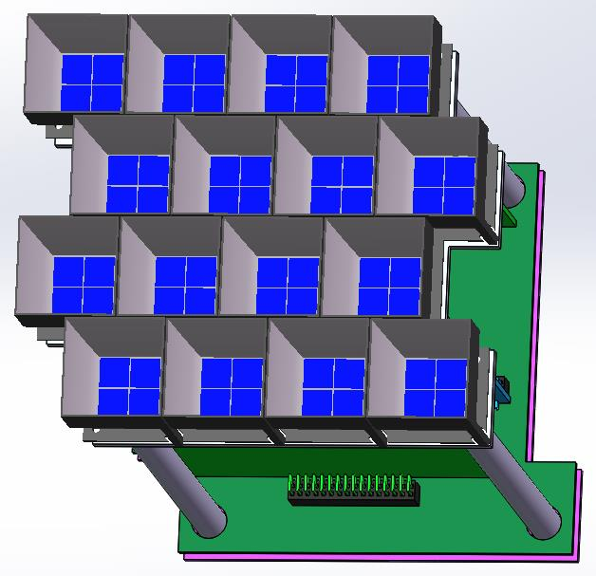
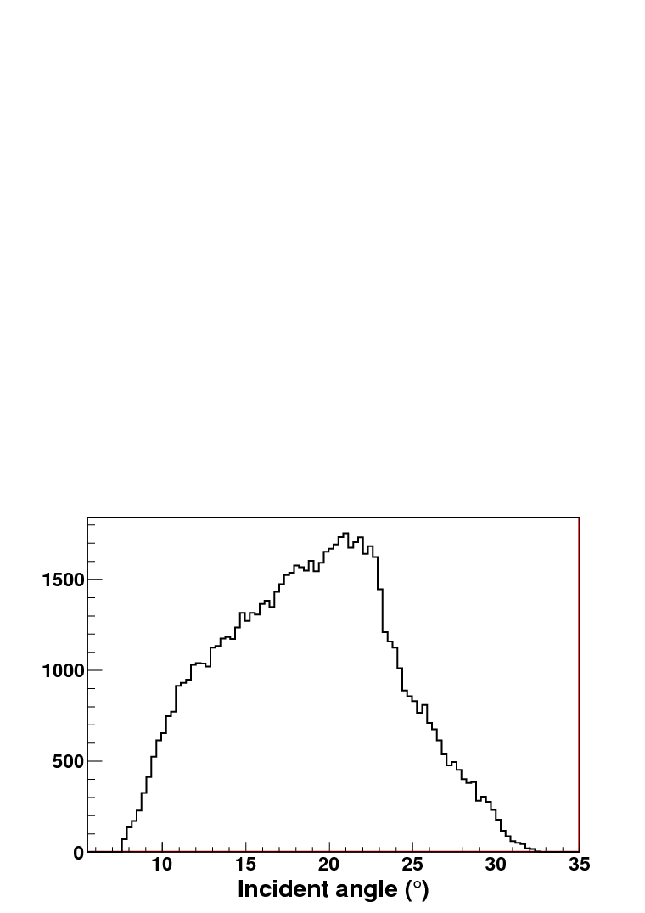
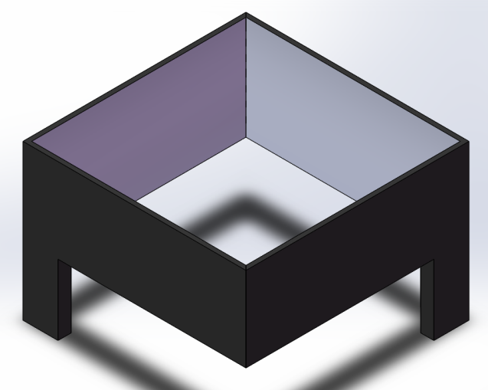
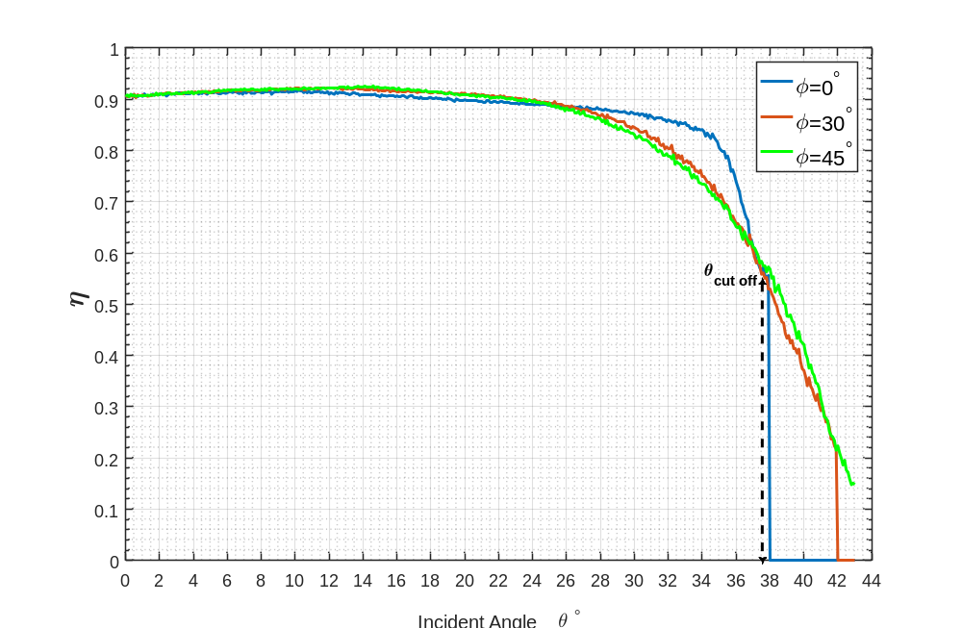

  Square SiPM：15 mm×15mm
light concentrators
Pixel size: 25.4 mm × 25.4 mm
SiPM size: 15 mm × 15 mm
Outlet: 15 mm×15 mm
Inlet: 24.4mm×24.4mm
Height: 25.3mm

Slide 12
16 ×
Data
DB
Trigger & Data Buffer & Communication Board
4 × 4 SiPMs & Preamplifiers
Low
gain
50M 14 bit FADC
FPGA
Single trigger
Synchronizing
High
gain
50M 14 bit FADC
Event trigger
Temperature
High
voltage
AB
Slow Control Board
BDB
64 ×
The architecture
of SiPM camera
readout electronics
TCP/IP
Low voltage power supply
Switch
TCP/IP
The SiPM gain (break down voltage) is sensitive to the temperature.
Slow Control Board: temperature & high voltage compensation loop.
Service

Slide 13
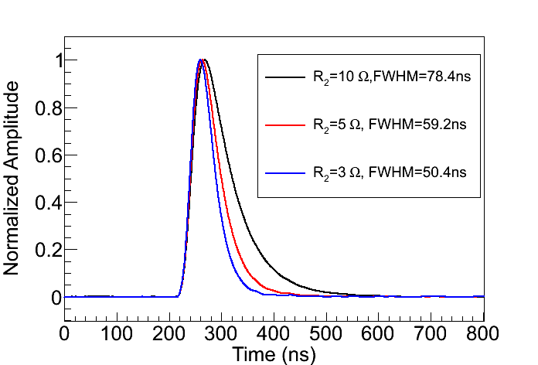
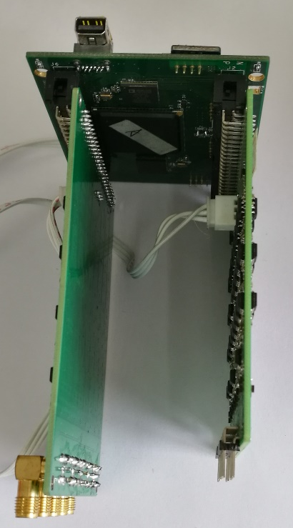
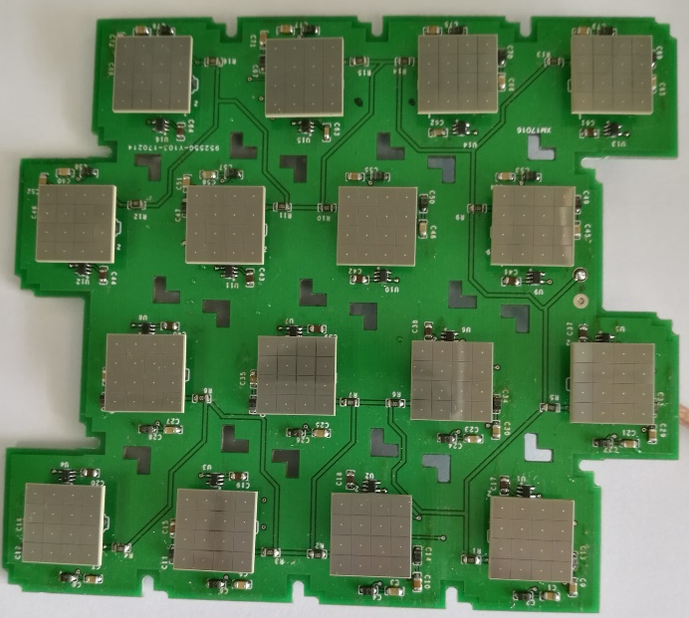
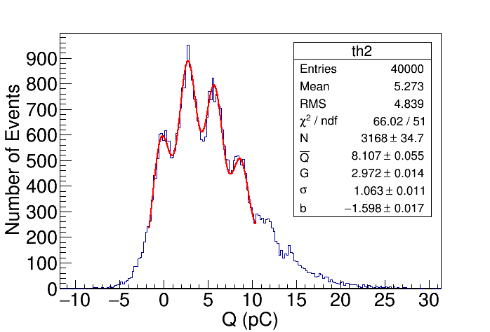
v_{cc}
Pre-amplifier
R0
C1
R3
SiPM
R2
-
+
R1
OPA 846
Low light intensity response
1pe
2pe
0pe
3pe
A prototype of SiPM board
A prototype of AB
and DB board

Slide 14
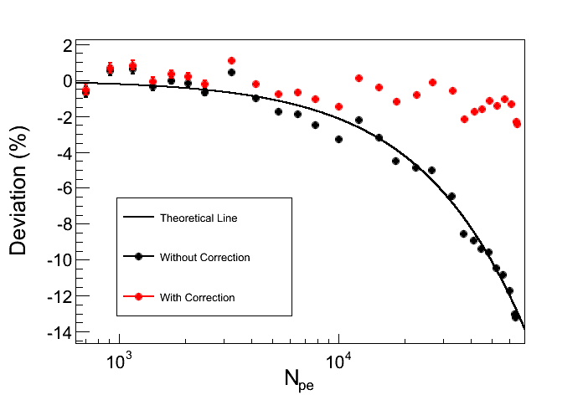
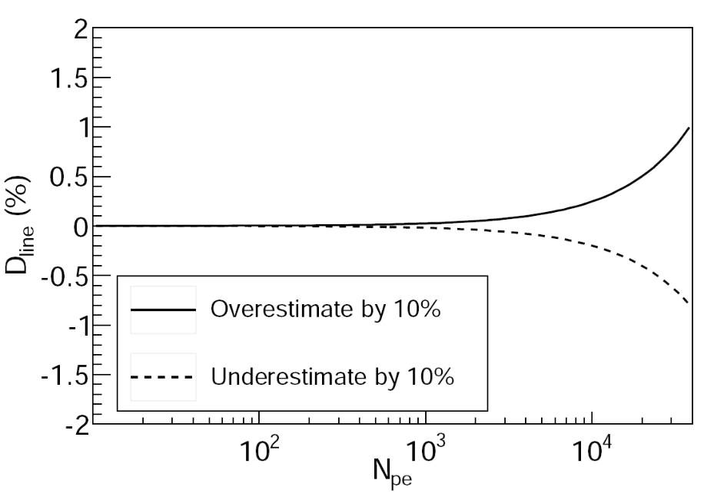
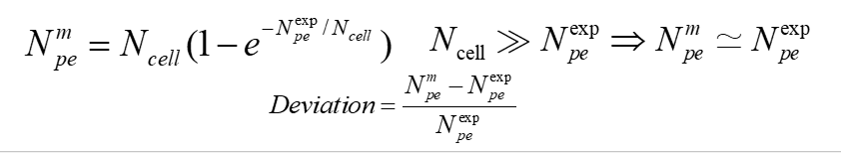
  HAMAMASTU SiPM
The deviation <1% @ 32000 pes, if the SiPM gain is overestimated or underestimated by 10%.
N_{cell} =230,400
The dynamic range of the SiPM is proportional to the total number of cells.
  Larger area SiPM has a bigger DCR.
  The small APD size: will produce small fill factor and then small PDE.
  SiPM with photosensitive area=15mm×15mm and APD size=25μm is selected.

Slide 15
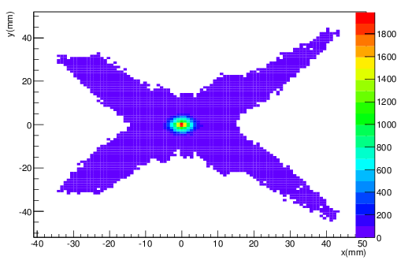
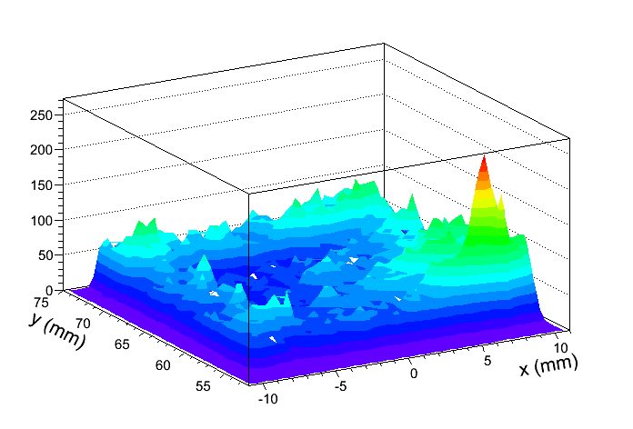
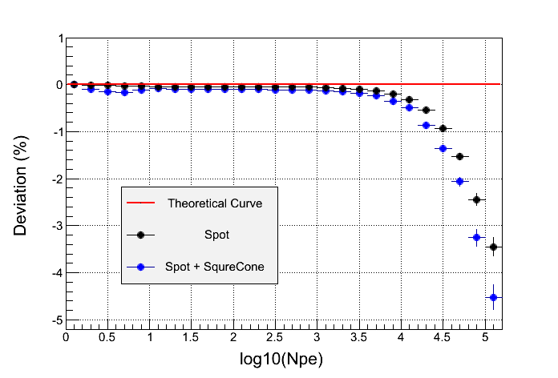
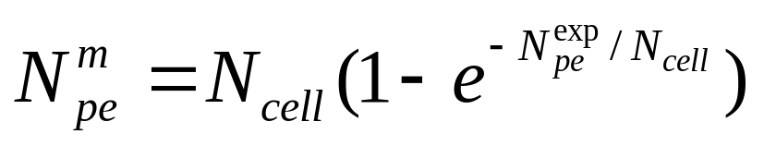
Light spot from the reflective mirror
Light distribution output from the cone
Estimate the non-linearity from the non-uniform light distribution cause by the light spot and the light concentrators
~1.5% @ 32000 pes

Slide 16
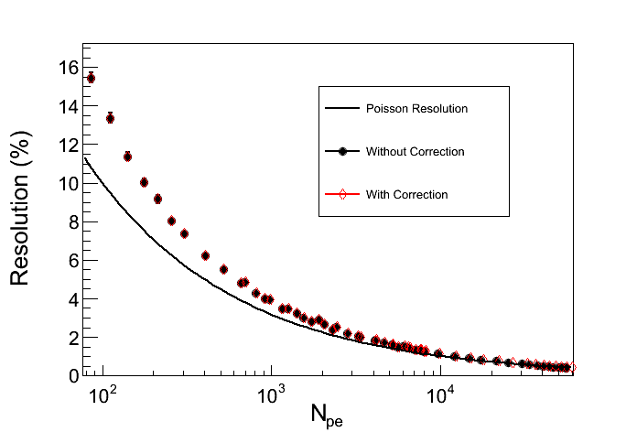
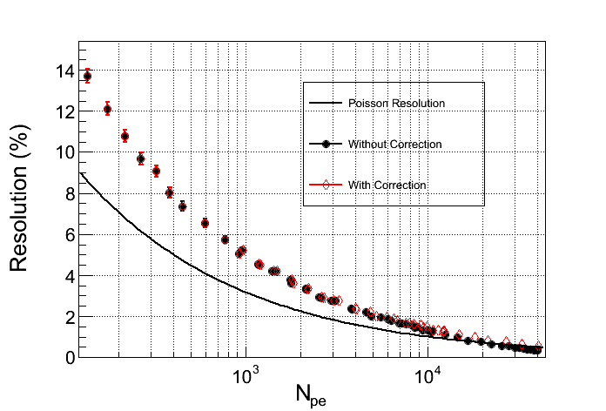
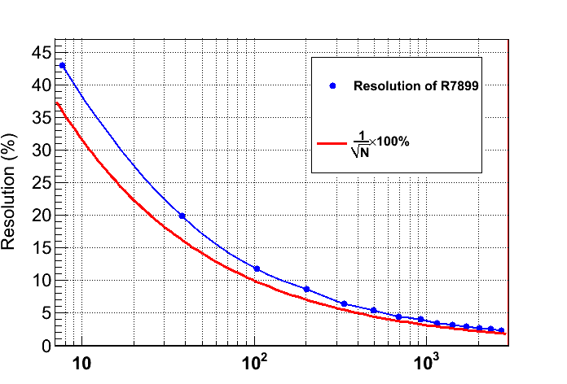
FBK
  HAMAMASTU
SensL
PMT
Charge resolution:
  SiPM: ~5%@1000pe
  PMT: ~4%@1000pe

Slide 17
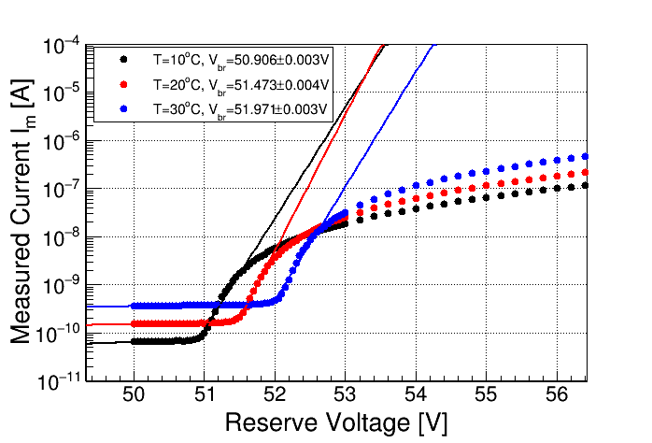
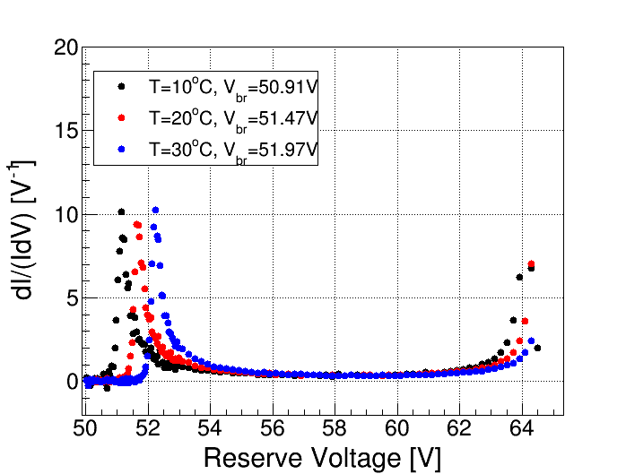
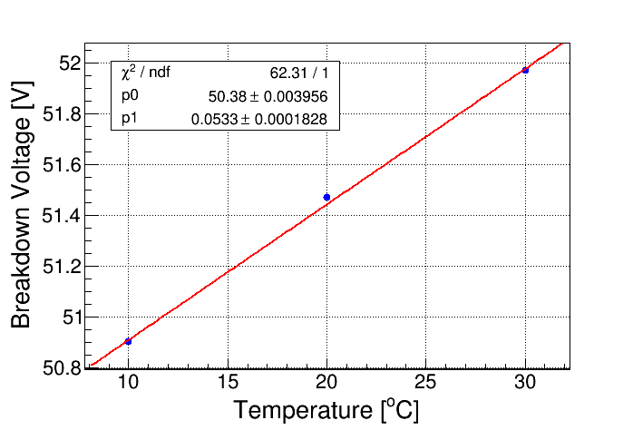
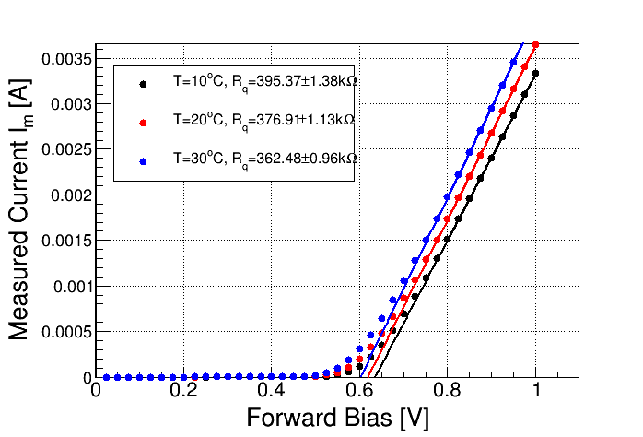
  I-V curve for breakdown voltage and quenching resistor
Linear fit
Breakdown voltage: 53.3 mv/℃
Gain: ~1.5%/℃

Slide 18
Gian monitor
UV-LEDs are mounted at the center of the mirror to monitor and calibrate the gain of the SiPM-based camera.
  The SiPM gain (break down voltage) is sensitive to the temperature.
  The voltage drop on the R0 (V_{R0} ) varies with the intensity of the sky background light. Accordingly, the supply voltage or the gain of the SiPM varies with the intensity of the sky background light.
  To monitor the high gain and the low gain of the electronics.
UV-LEDs configutation
  The photons intensity: ~3000 photons/pixel.
  Pulse width <20 ns and frequency of 1 Hz
  Monitoring accuracy: <1% per minute.
v_{cc}
R0
C1
Mirror
R3
SiPM
R2
UV light 400 nm
-
+
UV LED
R1
OPA 846
SiPM camera
The supply voltage of the SiPM is equal to Vcc-V_{R0} .

Slide 19
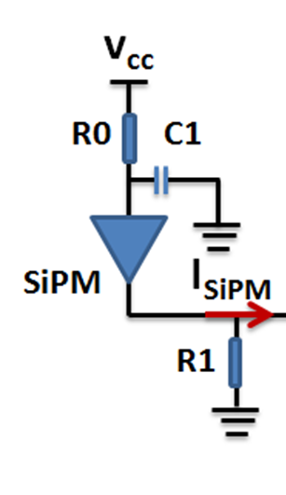
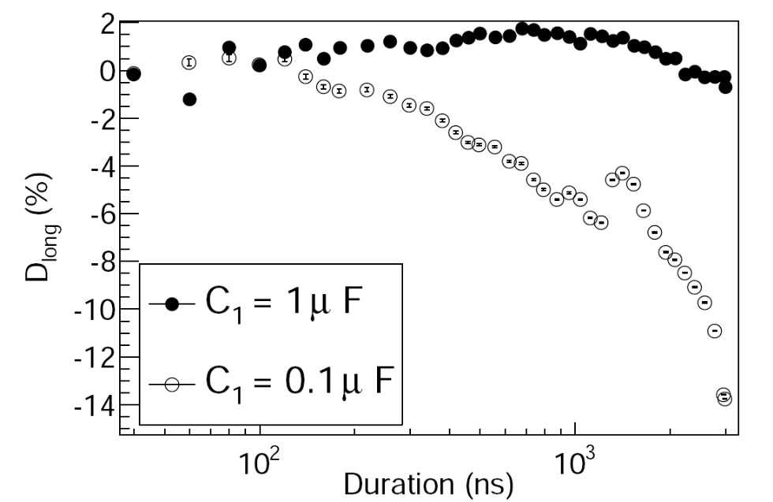
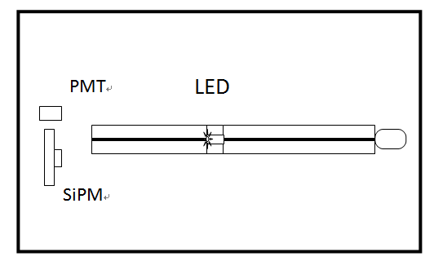
The long light pulse response
Light pulse duration
  Cherenkov light: 6ns – 50 ns
  Fluorescence light: tens of ns - 3us
The relative deviation is less than 2% with C1=1 μF.

Slide 20
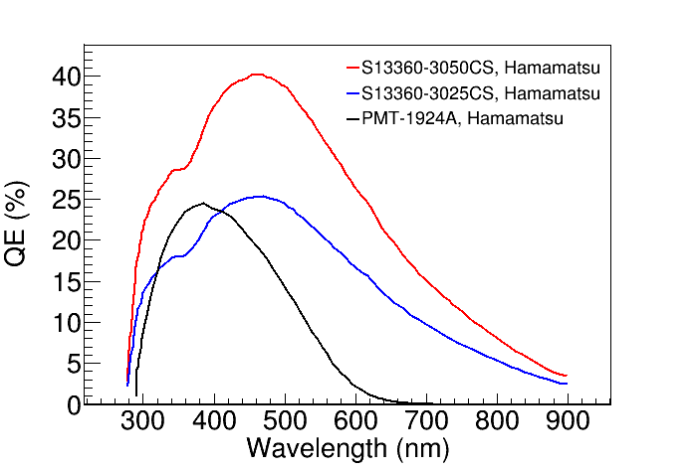

Sky background light spectrum
in the moon less night

Slide 21
Filter window：AR + cutoff

Slide 22


Signal to noise ratio
SiPM: 15mm×15mm，25μm
 | FBK | SensL | Hamamatsu | PMT （R7899）
Relative PDE/QE | 38%@400 nm | 31%@400 nm | 29%@400 nm | 16%@400 nm
Dark count rate | 18 MHz | 11.3MHz | 11.3MHz | <1kHz
Sky background noise | ~49 MHz | ~40 MHz | ~32 MHz | ~24MHz

Slide 23


Trigger algorithm
One of Cherenkov event
First level trigger：single channel trigger
Signal to noise ratio: S/N>n
Threshold varies with the intensity of the sky background light.
Second level trigger： pattern recognition
Fluorescence event
Site3
Site2
Round-shaped
pattern
Line-shaped pattern
Energy threshold of the telescope: ~30 TeV @ moonless night, ~300 TeV @ half moon night.
Site1

Slide 24
Summary
SiPM camera are designed and can meet the requirements of LHAASO-WFCTA
  SiPM-based camera can be operated on moon nights and achieve a longer duty cycle than PMT-based camera. The duty cycle of SiPM-based camera is about 30%, while the PMT is only 10%.
    -- Energy threshold of the telescope: ~30 TeV @ moonless night, ~300 TeV @ half moon night.
    -- SiPM based camera and PMT based camera almost have the same S/N at a moonless night.
Time schedule
  First SiPM camera will be built before Jan. 2018;
  6 telescopes based on SiPM camera will be built and run before the end of 2018.
  16 telescopes will be run at 2020.

Slide 25
Thank you for your attention!

Slide 27

North
Moon trajectory
East
West
South
Cherenkov telescope array: 16 telescopes are aimed from north-east to north-west.

Slide 28
    SiPM candidates: HAMAMATSU, SensL and FBK
 | FBK (25 μm) | SensL (25 μm) | Hamamatsu （25 μm）
PDE | 38%@400 nm | 31%@400 nm | 29%@400 nm
Fill factor | 72% | 62% | 47%
Dark count rate | ~80kHz/mm² | ~50k/mm² | ~45k/mm²
Optical cross talk | ~15% | ~5% | ~1%
Gain | ~2×10⁶ | ~0.9×10⁶ | ~0.7×10⁶
Break down voltage | ~26.5V | ~24.5 | ~53V
Gain vs. temperature | ~1.5%/℃ | ~1.5%/℃ | ~1.5%/℃
Break down voltage vs. temperature | ~26 mv/℃ | ~24 mv/℃ | ~54 mv/℃

Slide 29

荧光观测模式布局
荧光事例

Slide 30




